Slide 1
Graphs for Weka paper

Slide 2
Activated
a
Resting
a
100 μm
100 μm
b
b
c
c
Notes:
Example single images from procesing and analysis workflow. Images presented are one Activated and one Resting microglia example, including the image processing used before TWS analsys (a). Section b shows single image output from TWS of the chosen classifier for full dataset analysis. Hand count markers from Observer B included in section a and c to demonstrate the variability in morphology and presentation. Hand count markers were placed based on 2 or 3 images in the same field, but different focus depths.

Slide 4

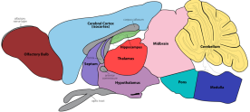

Genotypes: Resting (WT) activated (gp120tg)
6 male mice
3 Iba-1 stained Sagittal sections each mouse brain
Training Data:
Resting =5
Active =5
3 fields of view at 10x in cerebral cortex
2/3 images at diff. focus depth
TWS
Validation Data:
Resting =5
Active =5
Unseen Dataset:
Resting =22
Active =20
Notes:
Animals /images

Slide 5
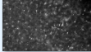
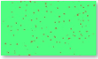
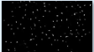
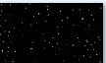
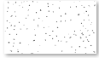
ORIGIN
Training Data
X 10
TWS
Classifiers
.model files x 25
Validation Hand Counts
.roi files x 10
Validation Data
TWS .BSH
25 x Classifier folders
Weka Output
25 x Classifier folders
25 x Classifier folders
23 images
Weka Output Thresholded
25 x Classifier folders
25 x Classifier folders
25 x Classifier folders
Weka Output Projected
25 x Classifier folders
25 x Classifier folders
25 x Classifier folders
The Count.IJM
10 images
Weka Output Counted
25 x Classifier folders
25 x Classifier folders
25 x Classifier folders
Script.R
Results.csv
Notes:
Folder breakdown
Text: Fig. # File and folder location diagram of trainging and validation of auto counting methodology using TWS. All folders are generated and populated with files automatically, with the exception of Training Data, Classifiers and Validation hand counts/ data. Blue boxes denote software and scripts used to generate files and output. The process for applying the classifier to the full dataset was identical to the validation process but involved only a single classifier.

Slide 6
ORIGIN
Full Dataset
TWS
Classifier folder
Weka Output
25 x Classifier folders
25 x Classifier folders
111 images
Weka Output Thresholded
Classifier folder
25 x Classifier folders
25 x Classifier folders
Weka Output Projected
Classifier folder
25 x Classifier folders
25 x Classifier folders
52 images
Weka Output Counted
Classifier folders
25 x Classifier folders
25 x Classifier folders
Script.R
Results.csv
Notes:
Applying trained classifier

Slide 7
Full Data
Training Data
X 10
TWS
Classifiers
Full Data Output
.model files x 25
Full Data Output Thresholded
Validation Hand Counts
.roi files x 10
Full Data Output Projected
Validation Data
TWS .BSH
25 x Classifier folders
Weka Output
25 x Classifier folders
25 x Classifier folders
23 images
Full Data Output Counted
Weka Output Thresholded
25 x Classifier folders
25 x Classifier folders
25 x Classifier folders
Weka Output Projected
25 x Classifier folders
25 x Classifier folders
25 x Classifier folders
The Count.IJM
10 images
Weka Output Counted
25 x Classifier folders
25 x Classifier folders
25 x Classifier folders
Script.R
Results.csv
Notes:
Folder breakdown
Text: Fig. # File and folder location diagram of auto coutning methodology using TWS. All folders are generated and populated with files automatically, with the exception of Training Data, Classifiers and Validation hand counts/ data. Blue boxes denote software and scripts used to generate files and output.

Slide 8
Data 8_10_2021

Slide 9
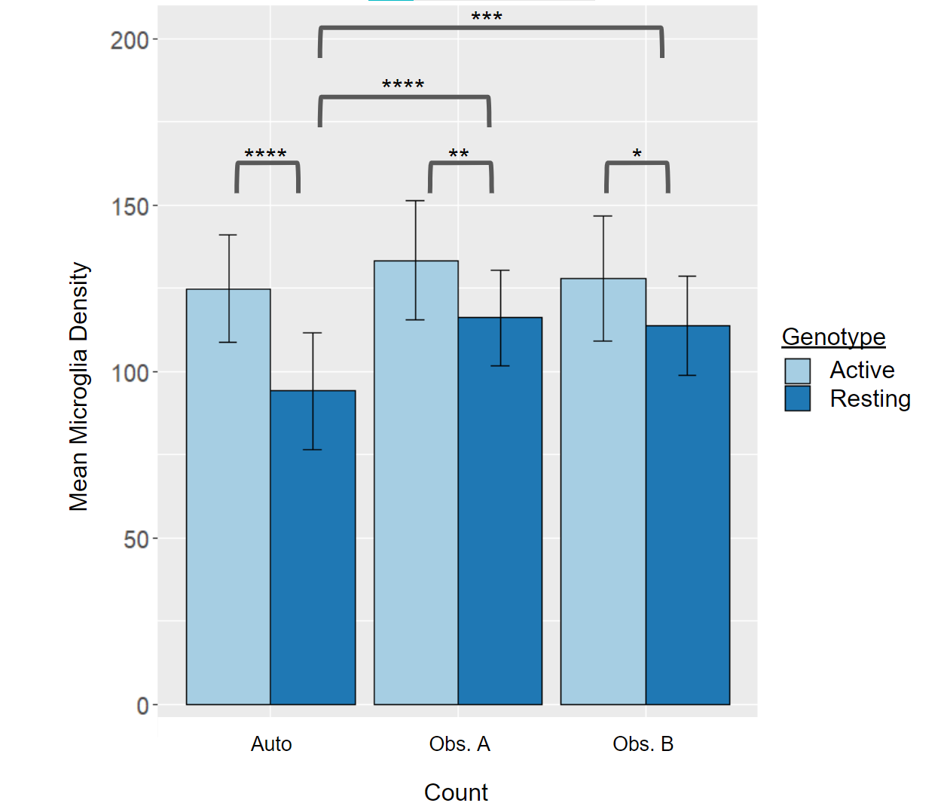
Notes:
Fig. # mean microlgia count by genotype in manual and automated counts. All counting methods found an increase in microglia density in Active microglia images by two sided T Test. The Automatic count density was significantly lower in the resting images than for both Observers. This was due to the TWS classifier’s difficulty identifying particularly faint cells.

Slide 10
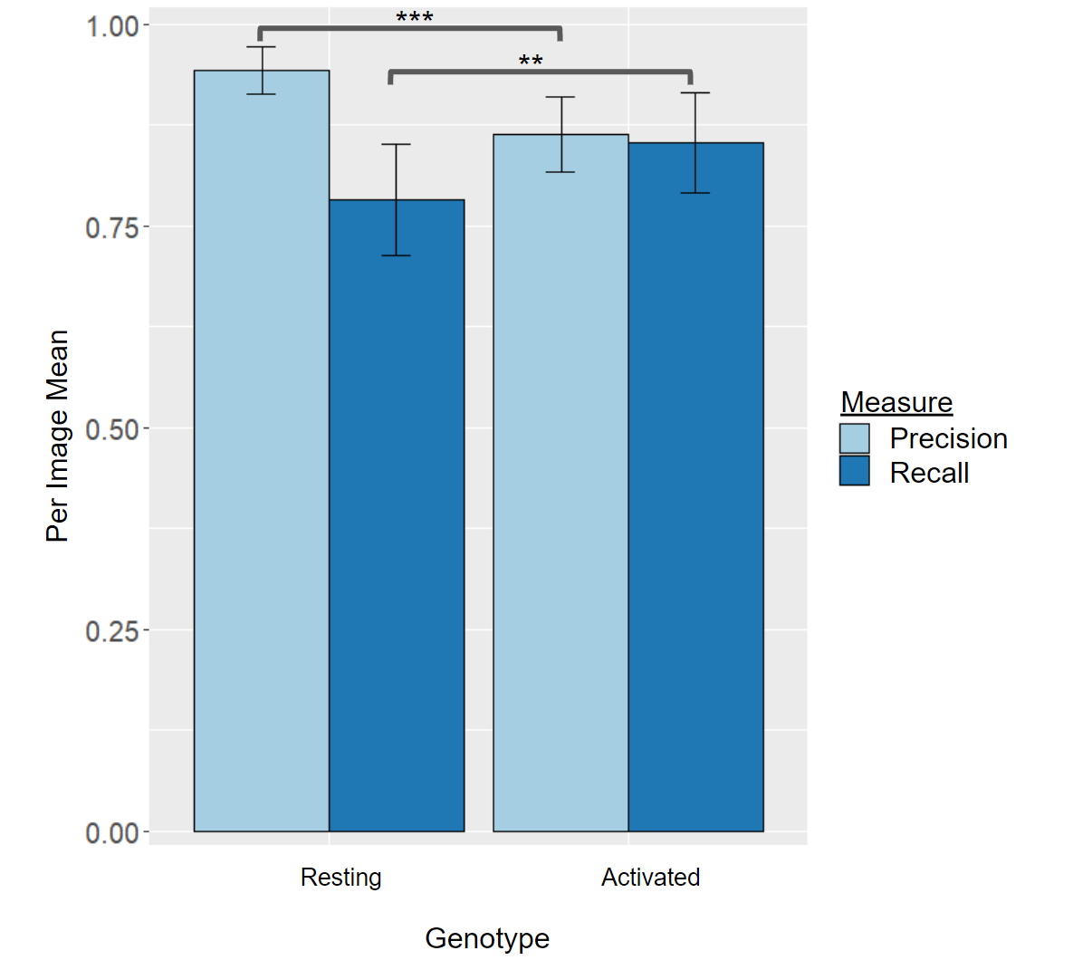
Notes:
Fig. #. Accuracy Measures in Restign and Active microglia images. Precision was significantly greater in Resting images compared to Activated (). Recall however was lower in activated images compared to the Activated images. This represents an increase in proportion of correct cells at the cost of missing an increased number of cells in each image.

Slide 11
Notes:
Tp vs fp vs total

Slide 12
 | Resting |  | Activated
Correlation | p val. | Adj. R² | p val. | Adj. R²
Automatic vs Observer A | 2.91e⁻⁶ | 0.657 | 0.0018 | 0.394
Automatic vs Observer B | 1.97e⁻⁷ | 0.737 | 0.00034 | 0.492
Observer B vs Observer A | 3.69e⁻⁶ | 0.649 | 0.00084 | 0.441
Notes:
Table 2. Correlation analysis of microglia density. The auto count correlated with both hand counts in both experimental conditions. Correlations were stronger in Resting than in Activated microglia images. The automatic count correlated with Observer B’s count overall more than Observer A’s count correlated with Observer B’s, showing similar variability via correlation as found between the two hand counts.

Slide 13
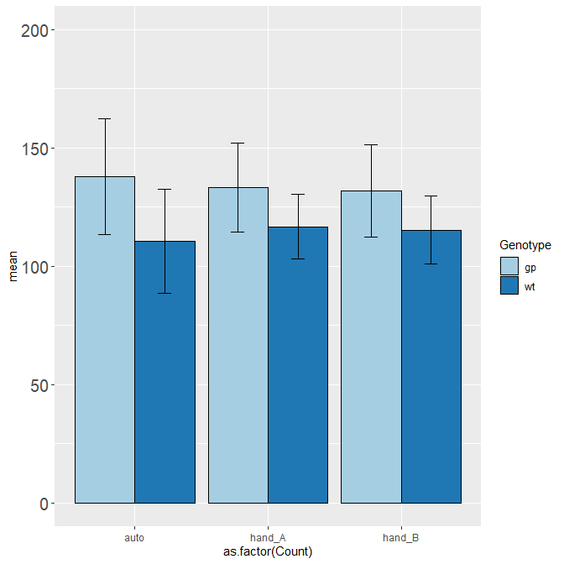
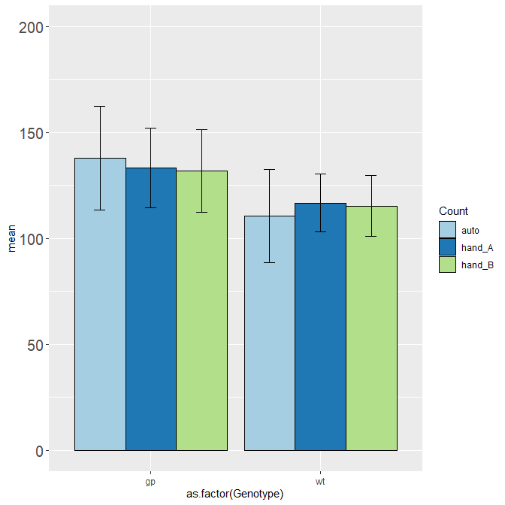
Notes:
Overall sig for both hand counts and auto

Slide 14
Notes:
Correlation plots

Slide 15
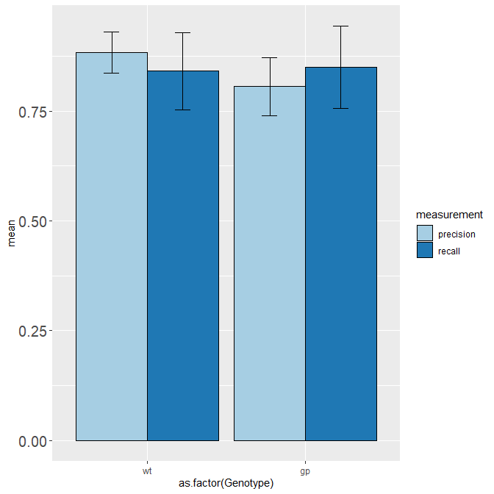
Notes:
Precision and recall for auto vs theo hand count

Slide 16
Notes:
The histogram with difference from hand? Should be diff from average perhaps?

Slide 17
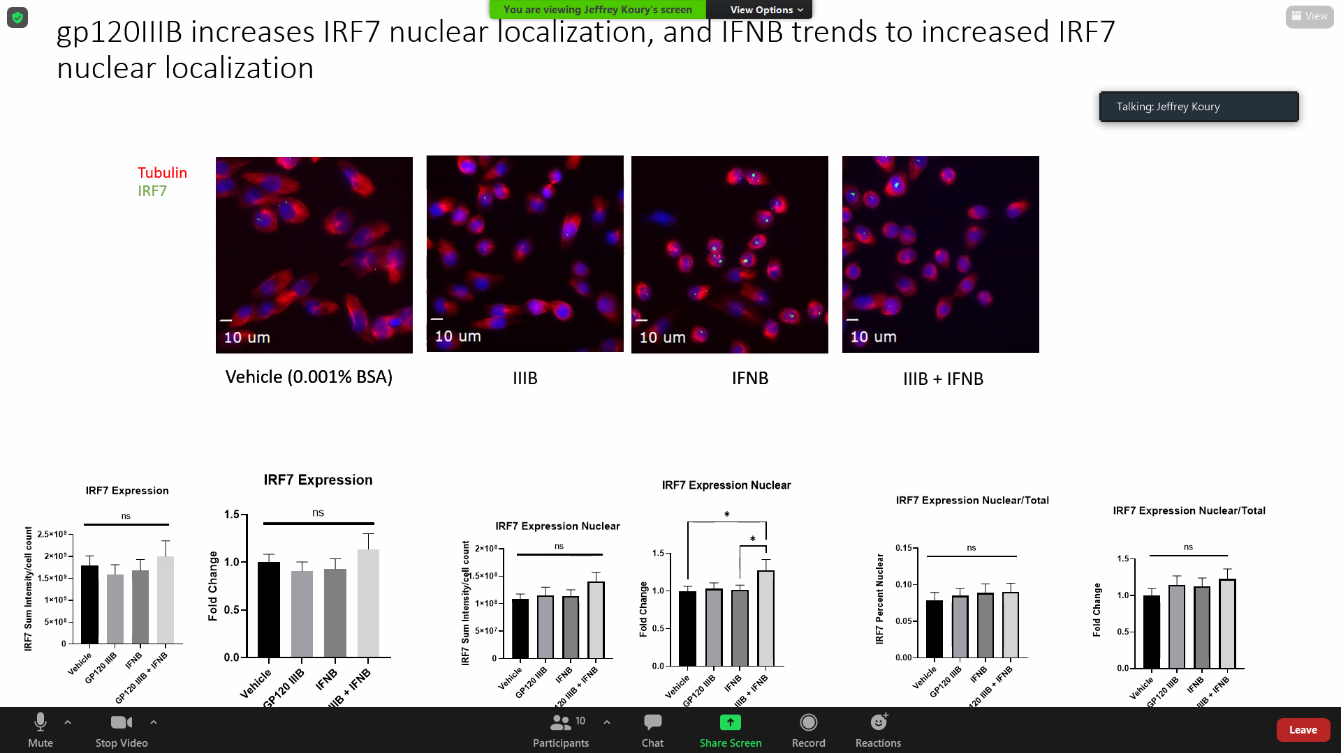
Notes:
Total cell #, true pos etc for hand and theo count

